Slide 1

Software
Digital Technology | Chapter 2

Slide 2

What the Specification Says…
describe the functions of system software, referring to allocating the following:
  memory;
  storage;
  processing time;
describe the following modes of processing: real-time, batch and multi-user;
describe the following tasks carried out by the utility applications: disk defragmenting, task scheduling, backup and restoring data;
describe the role of antivirus software and the importance of regular updates;

Slide 3
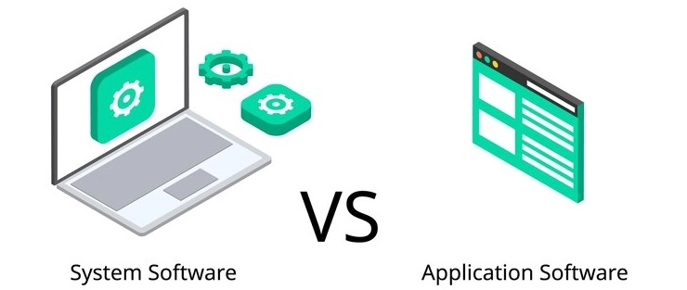
Software
The instructions that control the hardware within or connected to a computer system. This includes the memory, processor and storage devices.
It falls into two main categories:

Slide 4

The Categories of Software
What we HAVE to do to use a computer
What we WANT to do on a computer.
System Software
Application Software
Operating System
Utility Software
Packaged Software
Tailored Software

Slide 5
Software
System Software:
  The interface between computer hardware and user application programs
  Enables computer to operate its hardware and application software
Application Software:
  Enables the computer to do a particular task (i.e. word processing)

Slide 6
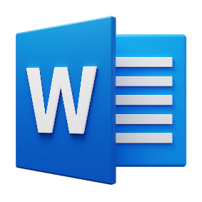
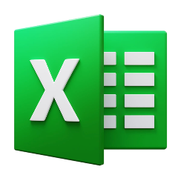

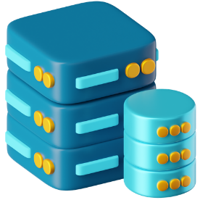

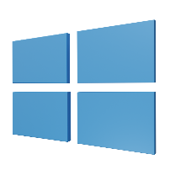

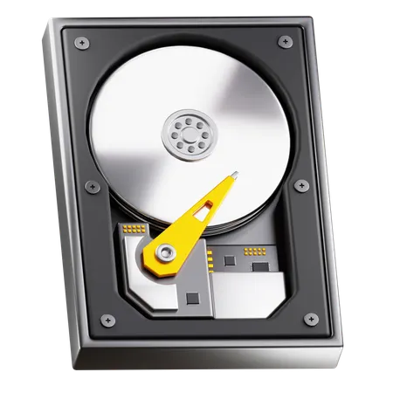
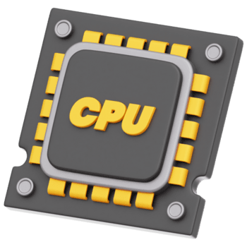
The Architecture of Computing
Software comprises of System Software (which manages hardware) and Application Software (which enables users to do tasks).
Application Software
Word Processors, Web Browsers, Databases, etc
System Software
Operating system, device drivers, Utilities
Hardware
CPU, Disks, Memory, Peripherals

Slide 7

Managing the Engine
System Software
System software interfaces the hardware and application software for efficient execution, and is involved in sending communication signals around the computer.
Operating Systems: Manage memory, CPU, and storage
Utility Programs: Perform maintenance tasks (such as security)

Slide 8
The Main Functions of System Software
System Software
Allocating Memory
The OS organises the use of main memory between programs and data files
Data needs to be transferred from a HDD/SSD to main memory (i.e. RAM) before it can be used.
Locates free memory in RAM and allocates this to the program/file
Storage
The OS manages the storage of data and files
Unnecessary files can then be deleted
Processing Time
System software allocates processing time between running programs and the users.
Uses time slices. More important task gets more time slices.
System performance includes response time and processor usage.
Monitored by the system software

Slide 9

Processing Data
System Software
So we know computers process data – they take input in, do something with it, and then output it to the user. And there are different ways a computer can do this:
Immediately process the data as soon as it’s entered – called real time processing
In groups of similar data, processed as a group at once – called batch processing

Slide 10

Real Time Processing
System Software
Processing the data immediately is essential to avoid disastrous results – the output needs to be obtained quickly as it is time sensitive.
Would you need to know exactly where a plane is at any one time?
Would it be OK to sell a concert ticket even though it’s sold out?
Playing on console? Would it be ok to have a delay until everyone has pressed a button?

Slide 11
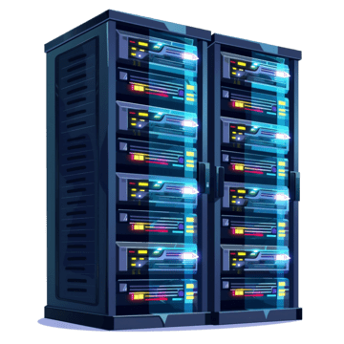

Real Time Processing
System Software
Outputs are generated quickly (almost instantly). This allows the results of processing to be produced quickly with little manual work.
Let’s look at an example:
CONCERT SERVER
01010111010101000101100111001010101011100101110100100111011101010111010001011
#1
#2
#4
#3
As soon as data it entered into the computer system, the system starts processing. For example, as someone connects to a booking system, their data is processed immediately.

Slide 12
Batch Processing
System Software
Transaction File
Data is collected, but not ‘sent’ to process.
These batches can then be processed at a convenient time without disruption.
Usually programs that implement batch processing tend to have high volumes of data to collect and process.
Merge Process
Updated Master File
Master File

Slide 13
Batch Processing: Electricity Billing System
System Software
When a reading has been collected, the customer account number and reading are entered onto the computer.
  This is used to create a transaction file.
Using the customer number on the transaction file to match with the master file, all customer information can be retrieved and the calculation of the bill can take place (including discounts/customer loyalty schemes/etc)
Finally, the ‘batch’ of generated bills is then sent out to customers.
Once a payment is made, the transaction history of the master file can then be updated.

Slide 14

Batch Processing Example
System Software
So, during an off-peak (quieter) period (such as overnight) or when a certain number of batches have been received, the processing will start.
The Master files are updated using the corresponding transaction files (which are then discarded)
Throughout the day, data is entering the system
Electricity Company’s BILLING SERVER
Customer ID: 0001
Meter Reading: 120
ELECTRICITY BILL
-----------------------------
Customer: 0005
Address: 10 Downing Street
Bill: £1.2b
1001011101011010100
ELECTRICITY BILL
-----------------------------
Customer: 0005
Address: 4 Privit Drive
Bill: £9.75
ELECTRICITY BILL
-----------------------------
Customer: 0001
Address: 64 Zoo Lane
Bill: £50
00110110101101010111
Customer ID: 0010
Meter Reading: 90
1010111001110100110
Customer ID: 0005
Meter Reading: 85
Customer ID: 0001
Reading History: 80, 200,120
Address: 64 Zoo Lane
Customer ID: 0001
Meter Reading: 120
Customer ID: 0001
Reading History: 80, 200
Address: 64 Zoo Lane
You’ll notice the server is not processing the data – it’s just collecting it.
This data is held in the server temporarily and are called transaction files.
Customer ID: 0005
Reading History: 100
Address: 4 Privit Drive
Customer ID: 0005
Meter Reading: 85
Customer ID: 0005
Reading History: 100,85
Address: 4 Privit Drive
The Server has access to the Master Files, which is are semi-permanent files which do not update in the short term and will only update when the processing starts.
Whilst the results of processing (outputs, in this case the bills) are sent out to the customers.
Customer ID: 0010
Reading History: 300,250
Address: 10 Downing Street
Customer ID: 0010
Meter Reading: 90
Customer ID: 0010
Reading History: 300,250,90
Address: 10 Downing Street

Slide 15
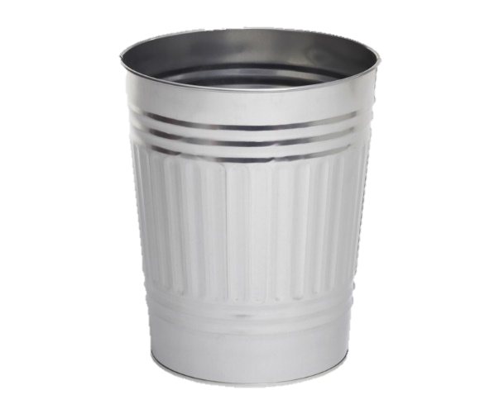
Batch Processing: Example
Transaction File (Temporary)
Holds details of transaction, will be discarded after process
Mr Butler 001
--------------------------------
Statement
--------------------------------
This bill has been automatically generated.
Total: £150
System Software
Merge Process
Customer ID: 001 Bill: £50
Mr McHugh 002
--------------------------------
Statement
--------------------------------
This bill has been automatically generated.
Total: £125
Customer ID: 002 Bill: £75
Master File
(Permanent/Semi Permanent)
Does not change in short term
Result of the processing comes out. Usually in the form of a bill or report
Customer ID: 002
Name: Mr McHugh.
Outstanding Balance: £50
Customer ID: 001
Name: Mr Butler.
Outstanding Balance: £100
Master file is updated as a result of the processing, such as bill history
Transaction file is then discarded after processing
Notes:
TAKE NOTES USING THIS DIAGRAM

Slide 16
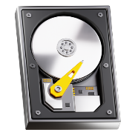
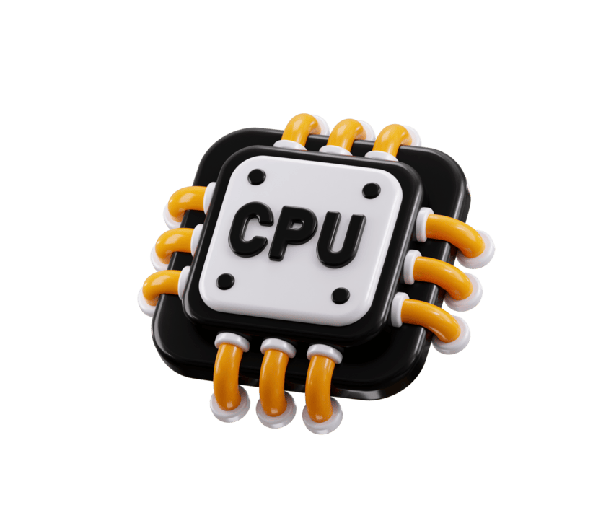
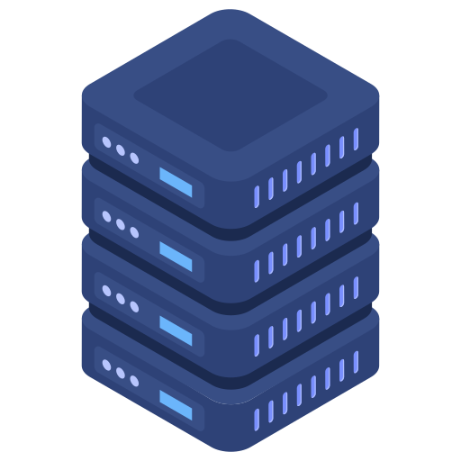
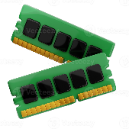

Multiuser Systems
System Software
Multiuser System
Many users at different computers sharing the processor of a powerful computer.
Known as a ‘time-sharing’ system.
The OS switches between computers, giving a lot of processing power (a time slice) for a short time before going to the next in line.
This is sometimes known as a round robin approach to processing
This is often used in servers and websites
All users feel as if they are the sole user of the system
Resources
User
User
User

Slide 17

Utility Software
System Software
This is a program that carries out a specific task to assist the OS.
  Disc Defragmentation
  Task Scheduling
  Data backup / restore
  Antivirus
WinZip and Malwarebytes Antimalware would be an example of utility software

Slide 18
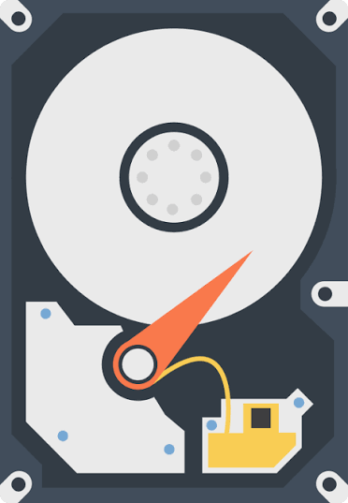
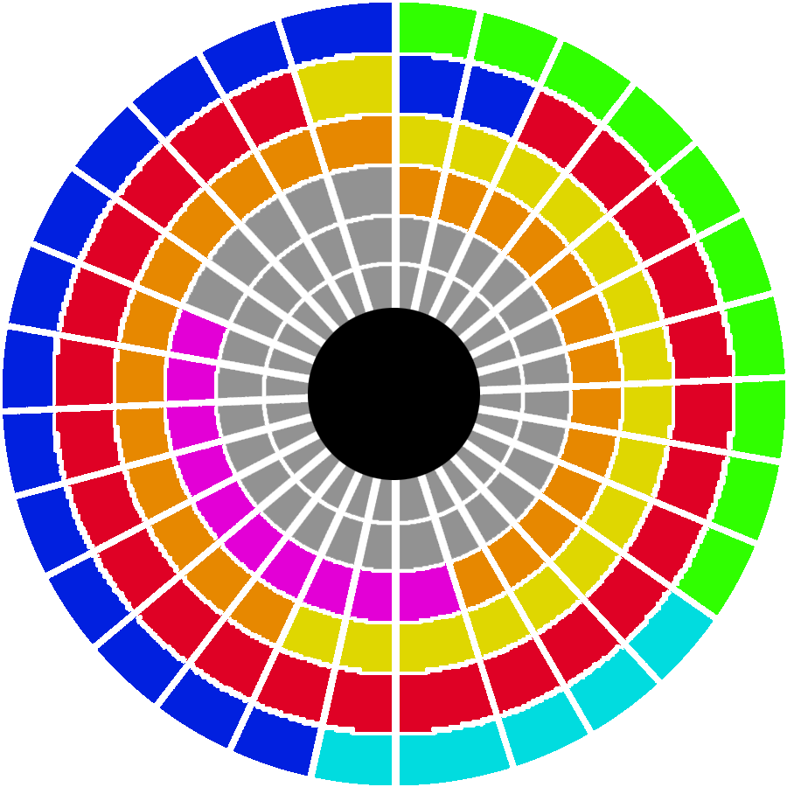
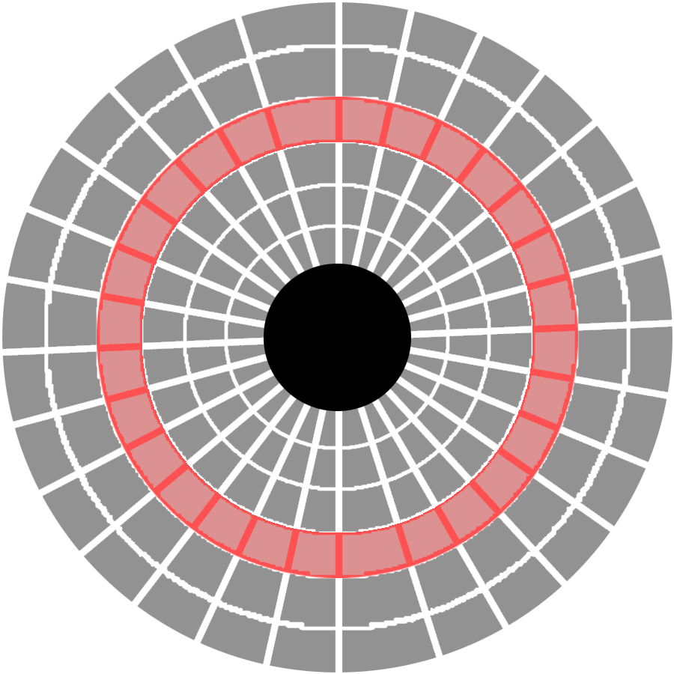

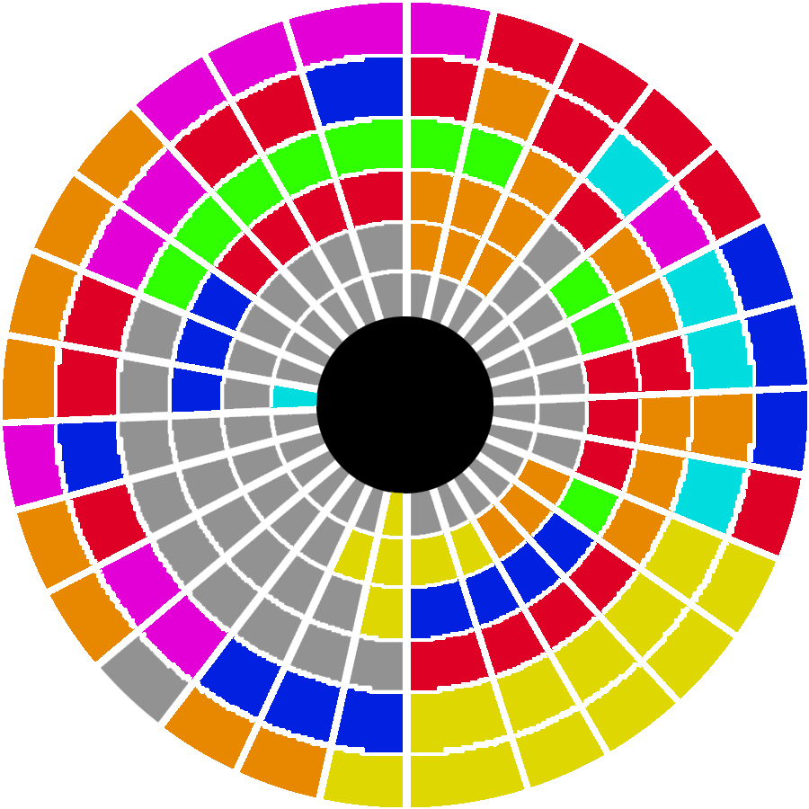
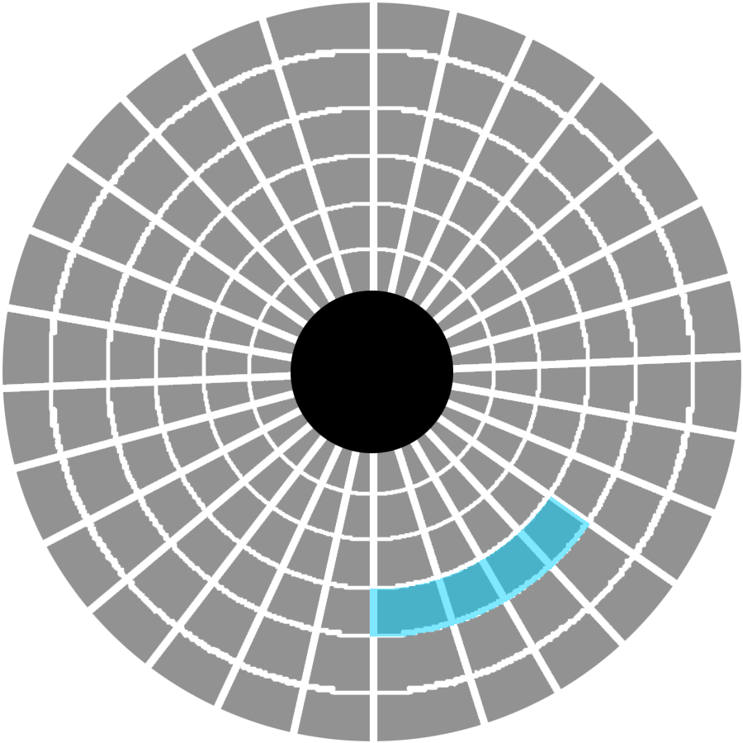
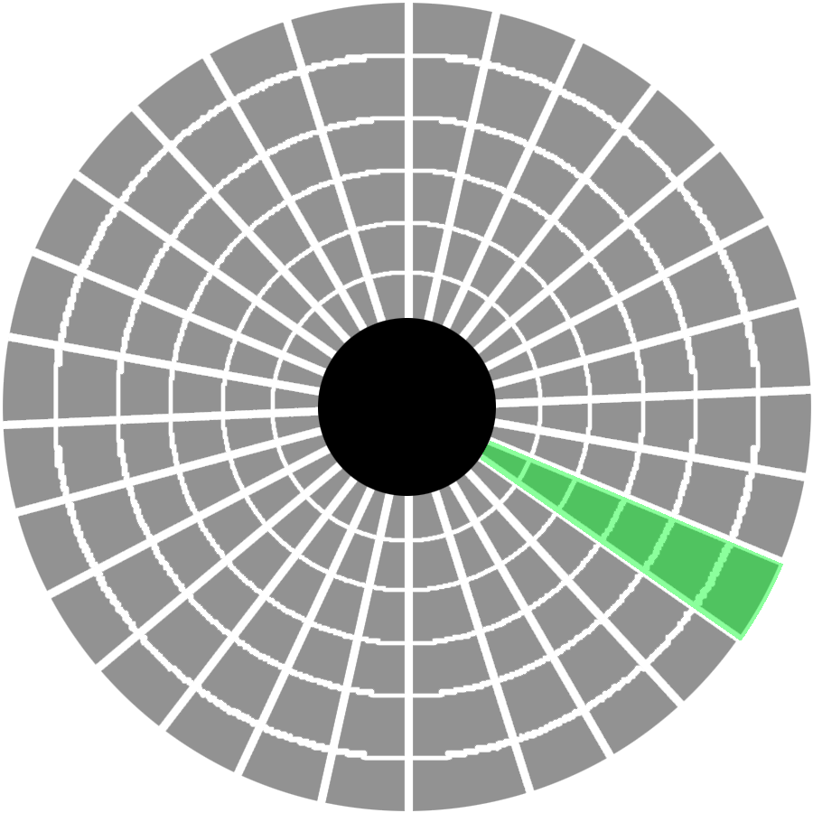
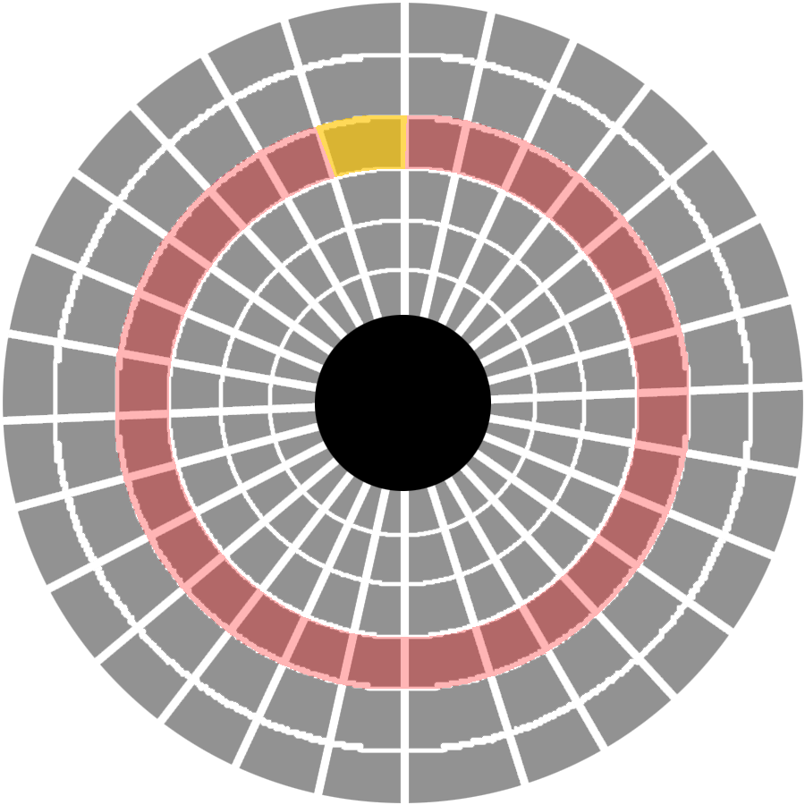

Defragmentation
System Software
Hard drive
TRACK
A computer stores its files on a disk, and even though large disks may not have a single continuous block of empty space to hold a single file, computers ‘break up’ a file into little parts, or fragments
This means that a hard disk has to search for all the files until it can recreate the file on screen.
Defragmentation speeds up saving and reading time when accessing files.
Track sector
Cluster
Disk Sector
Fragmented Disk
Defragmented Disk
The Drive head

Slide 19
Defragmentation
System Software
Block in memory
A1 | B3 | A2 | A4 | B2 | A3 | <FREE> | B1 | B4 | <FREE>
A1 | A2 | A3 | A4 | B1 | B2 | B3 | B4 | <FREE> | <FREE>

Slide 20
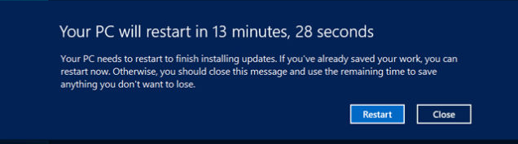
Task Scheduling
System Software
The operating system schedules programs to run at particular times.
  For example, you may set some programs to run every week / once a day, or even launch programs on start up
Task scheduling might be set to autorun a program at a set time
It can give you an alert message before executing a job
These tasks might be to run virus checks or backups/updates etc

Slide 21
Data Backup and Restore
System Software
Data can be backup up to other hard disks, magnetic tape or to servers on the internet (cloud backup)
When everything on a hard disk is backed up, it is known as a full backup
This will take a long time, and so we may choose to only backup the data when it has changed. This is called an incremental backup

Slide 22
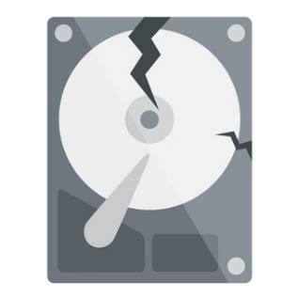
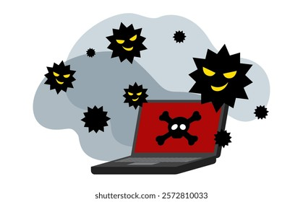
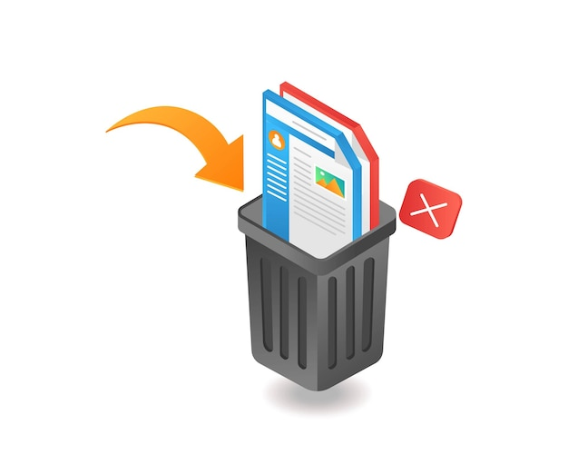
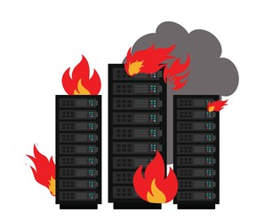
Quick Question
Q. Why do we need to backup our data?
Ans. We need to backup our data in case it gets damaged, lost or stolen.
We should keep a backup in case:
A virus infects the data
The hard drive fails
Users accidentally delete the data
A fire destroys the data storage facility

Slide 23
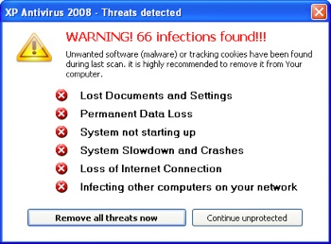
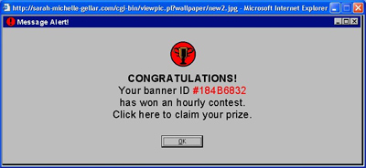
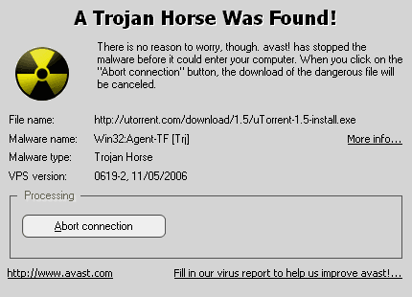

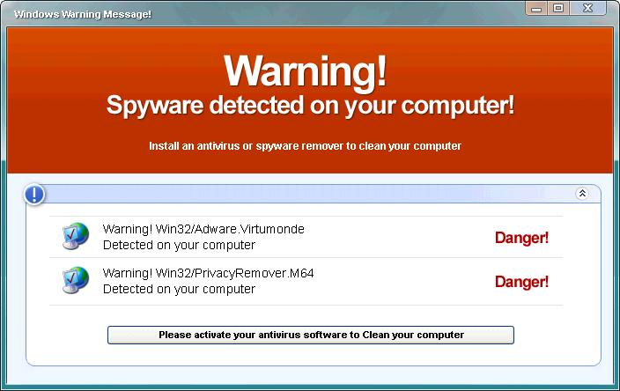
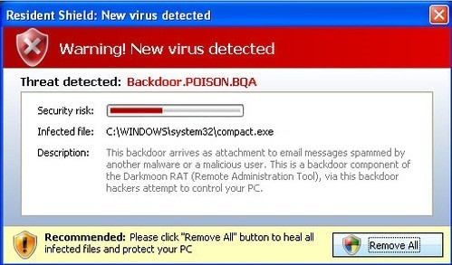
Anti-Virus
System Software

Slide 24


Anti-Virus
System Software
  A virus is a malicious software program designed to copy itself onto a computer in order to obtain, alter or delete stored data
Is it important to keep software up to date?
New viruses are created all the time to take advantage of security flaws in software. Software updates often ‘patch’ these security risks.
  Antivirus is a piece of utility software that is responsible for detecting, blocking and quarantining computer viruses.

Slide 25


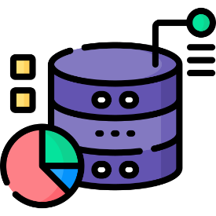
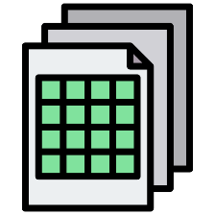

Application Software
Application Software
Application software is a program or set of programs designed to perform specific user-oriented tasks, allowing the end user to complete daily activities, solve problems, or process data.
It is built to complete certain jobs, including:
Word processing
Database Applications
Spreadsheet Applications
Computer Games

Slide 26
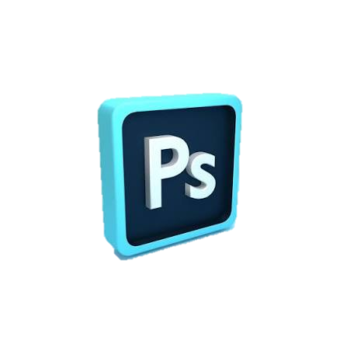

Packaged Vs Tailored Software
Application Software
Tailored SOFTWARE
PACKAGED SOFTWARE
Tailored software is a program that is developed for a specific organisation or person.
It usually comes with high cost as cost to build is usually on one user/company.
Documentation is not readily available, as again it’s usually linked to one company using it
For example, database management system for a school or bank
Packaged software is a program that is developed for common users.
It’s low cost, and sometimes freeware

